Slide 1
Hearing Loss Prevention for the Soldier
Army Hearing Program
Readiness, Operational, Hearing Conservation, Clinical
Approved for public release, unlimited distribution

Slide 2
BRIEFING OUTLINE
PURPOSE: To provide strategies for effectively minimizing noise-related threats in the training environment.
Scope of Threat
Hearing & Noise
Hazardous Noise Levels
Threat Mitigation: Hearing Protection
Operational Hearing Services
Combat Experiences
Conclusion

Slide 3
SCOPE OF THE THREAT
Permanent Hearing Loss = Top Four Injuries in Current OE
Current OPTEMPO
  Hearing Loss & Noise at highest rate in 30 years
7/10 Injuries are Due to Explosions and Blasts
  Potential Acoustic Trauma – 1 in 3 Soldiers
  50% of blasts result in damage to inner ear
Hearing Loss is the Only Injury without Symptoms
  No sensory nerves in the inner ear
  Gradual or Sudden – no way to predict Soldier susceptibility to loss
  Always Cumulative
Notes:
Permanent hearing loss is among the top four injuries in current theaters of operation and is the most under-identified injury, due to the nature of the symptoms.
a. Although symptoms include temporary hearing loss, where sounds and speech are muffled, and tinnitus (ringing in the ears), this does not include pain. Complicating matters, the initial symptoms often improve in time and there are no visible signs of injury (e.g., blood), leaving the Soldier with the impression that the injury is not permanent and has left no damage. Once damage to the inner ear begins, it leaves the Soldier vulnerable to a gradual or sudden decline in hearing with continued unprotected, hazardous noise exposures.
b. Seven out of ten injuries are due to blast injuries, with 50% of injured Soldiers suffering hearing loss. One in three unprotected, deployed Soldiers experiences acoustic trauma at some point during a deployment to a combat theater.

Slide 4
  Response to Threat: The Army Hearing Program
  Readiness, Operational, Hearing Conservation, Clinical
Prevention & Education are Key
  Understand the Threat
  Employ strategies to minimize Threat
Notes:
Education and Preventive measures are the key to mitigating the threat. Understand the threat, its potential impact, and how to stop the injury before it starts.

Slide 5
HOW CRITICAL IS HEARING?
For Soldiers, Good Hearing is Necessary:
Survivability and Lethality
  HEAR the enemy before seeing them!
Sound can be heard:
  In the dark or inclement weather
  360 Degrees - comes from all directions
  24 hours a day – 7 days a week
Collect intelligence
  50-60% of Situational Awareness is hearing; % increases when visibility is limited
  Tactical Intelligence (SitReps,latest enemy TTPs)
  Interaction with civilians (reliance on interpreters)
Notes:
Hearing is the only sense that is “on” 24 hours a day, 7 days a week, 365 days a year. It is not dependent on time of day or weather conditions. It is 360 degrees and isn’t affected by the Soldier’s level of alertness. The brain’s job is to keep you alive and in doing so, it will divert the Soldier’s attention to any new sound in the environment that may be a potential threat, even when they’re asleep (ask the listeners if they’ve ever been awakened by someone’s “snoring”, the example illustrates that the sense of hearing doesn’t shut down when going to sleep). It can sometimes be an annoying part of hearing, but it may also be what saves a Soldier’s life.
It’s estimated that 50-60% of situational awareness comes from hearing, through environmental monitoring or communications with others. Verbal commands/instructions, radio information, and intelligence gathering with the local populace are just a few ways we’re in constant communication during a mission. The percentage of auditory input increases any time the visual field is limited (e.g., darkness, building in the way, confined inside a vehicle, etc.).

Slide 6
Why OPERATIONAL Hearing?
Example: Tank Crew performance with & without hearing loss
(Garinther & Peters, Army Res., Development, & Acquisition Bull. 1990; Jan.-Feb: 1-5)
Notes:
This links hearing with survivability and lethality. This was a study done with tank crews. The crews were given radio orders (coordinates, instructions) filtered to create simulated noise-induced hearing loss, and then similar orders without the filters. Crew hearing was labeled “good” (unfiltered commands, crew had ‘normal’ hearing) and “poor” (crews heard filtered commands). The changes in performance indicated just how much hearing has an impact on performance. Highlight:
a. Time to Identify target: 40 seconds to 90 seconds (affects lethality)
b. Correctly Identified target: Dropped from 98% to only 68% (affects lethality - 30% of enemy just got away due to hearing problems)
c. Tank crew killed by enemy: Rose from 7% to 28% (affects survivability, 1 in 3 of soldiers were KILLED due to poor hearing).

Slide 7
CONSEQUENCES OF HEARING LOSS
Detection of Sound by Hearing Ability
46m
Rifle Bolt
Closing
210m
1000m
Poor Hearing plus a temporary hearing loss
(H-3)
Normal
Voice
32m
100m
Poor Hearing
(H-2)
180m
Detection distance
decreases rapidly as hearing loss increases.
Acceptable Hearing
(H-1)
Footsteps in
Leaves
0.6m
5.5m
100m
0
200
400
600
800
1000
Distance in Meters
Price, G. R., Kalb, J. T. and Garinther, G. R. (1989). "Toward a measure of auditory handicap in the Army", Ann Otol. Rhinol. Laryngol. 98, 42-52.
Notes:
Along the left side of the chart are three sounds: a rifle bolt closing, a normal voice and footsteps in the leaves.
Along the bottom of the chart is the distance where these sounds can be heard. For example, a Soldier with normal hearing can hear a rifle bolt close at 1000 meters, or slightly more that 9 football fields away, but with poor hearing plus a temporary loss, such as from unprotected exposure to one round fired by that Soldier or his or her buddy, the rifle bolt closing can only be heard approximately 50 yards away, or about ½ of a football field.
The colored bars on the chart represent three levels of hearing ability, labeled by medical profile rating.
The green bar represents hearing at H-1 profile.
The yellow bar represents hearing at H-2 profile.
The red bar represents hearing at H-3 profile with added temporary hearing loss.
A Soldier with hearing loss is at great disadvantage when compared to a Soldier with normal hearing. Hearing allows Soldiers to detect the threat and to communicate, both of which are critical for mission completion.

Slide 8
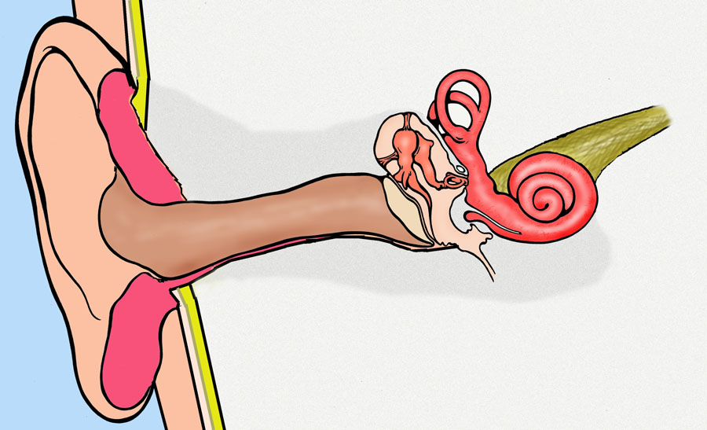
HEARING AND NOISE
Hearing Nerve
Noise = Vibrating Air Molecules
Ear Drum
Cochlea
(Inner Ear)
Damage!
Diagram Courtesy of Troels Loyborg
Notes:
This illustrates where hearing loss occurs. The irreparable damage occurs inside the cochlea, in the inner ear. If the eardrum is damaged, it will often grow back or can be surgically repaired.
How your ear works: sound travels inside the ear canal and vibrates the eardrum. The eardrum vibrates the three ear bones in a chain. The last bone moves a window connected to the inner ear, or cochlea. It creates a fluid wave at the start of the cochlea that flows through its chambers. (Provide an example to illustrate how this works: the fluid wave in the cochlea is created by the chain of bones similar to the way pushing on the side of an above ground pool would create a wave inside the pool. The harder and faster the wall is pushed, the bigger and more powerful the wave. The size and power of the wave generated inside the cochlea depends on how loud the sound is. The louder the sound, the harder and faster the bone pumps. The end result is a bigger wave inside the inner ear.)
How the damage occurs: the powerful wave from dangerous noise levels then moves down the first turn in the cochlea and can’t stop. It hits the first turn at full speed and crashes through, damaging the hair cells along the first turn of the cochlea by crushing them. The first turn of the cochlea is where high-pitched hearing happens. Hearing loss in this part of the inner ear impacts our ability to hear speech clearly.

Slide 9
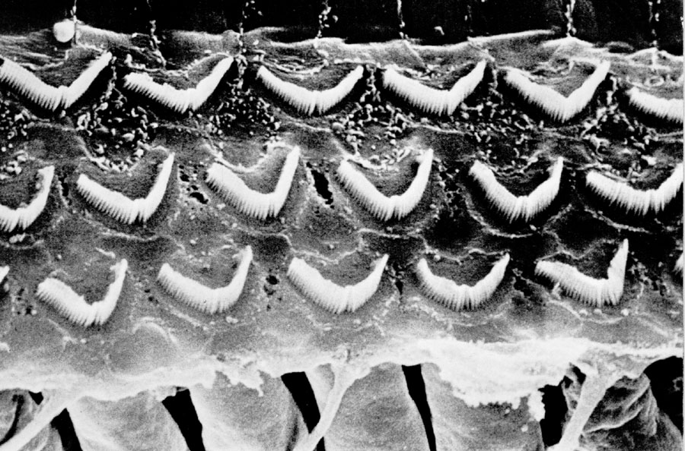
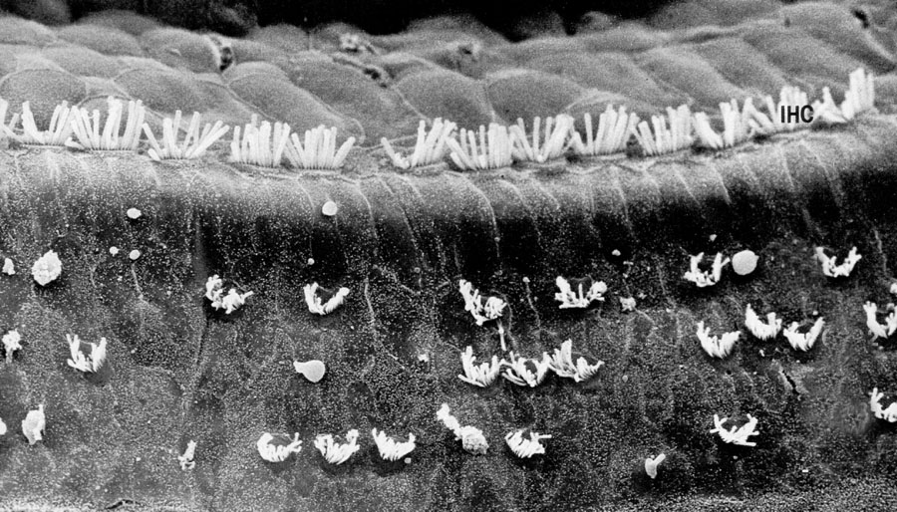
INSIDE THE COCHLEA
Healthy Hair Cells
(Hearing Nerve Endings)
Hair Cells Damaged by Noise
(Hearing Nerve Endings)
Healthy
Damaged!
Notes:
The first picture is one of healthy hair cells in the cochlea. The second picture is what it looks like after noise damage. Many of the hair cells are gone and will not grow back. Now the hair cells are missing, so when the membranes next to them try to move them, there’s nothing to bend and cause the hearing nerve to fire, which results in hearing loss. The bent hair cells are stuck in the bent position, which means the nerve underneath thinks they’re bending in response to a sound, so it fires over and over again, resulting in tinnitus, or ringing in the ears.
The hearing loss from noise exposure always starts in the high pitches. What that means is that Soldiers lose the ability to hear speech sounds, such as s, sh, t, k, ch, f,and h. These are the speech sounds that make it easy for us to understand speech when there’s background noise (such as when trying to hear grid coordinates on a radio). Next, our ability to hear where a sound is coming from , called localization, is affected. Some soft sounds are really hard to hear, like the subtle movements of a hidden enemy or the scrape of a metal weapon against the floor (high pitched). VERY important sounds for the Soldier to hear! It could mean the difference between life and death; between accurate enemy fire or friendly fire.

Slide 10

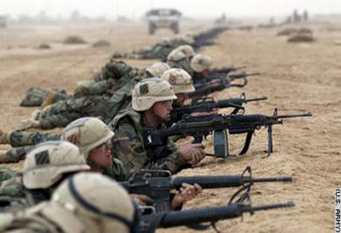
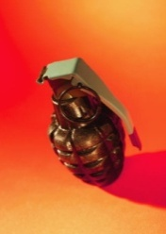
HAZARDOUS NOISE LEVELS
Noise Levels which Cause Hair Cell Damage:
Steady-state Noise > 85 dBA
  Steady-state noise = noise > ½ second in duration
    All tactical vehicles (including HMMWVs)
    Most generators
    Rotary wing aircraft
  Tends to cause gradual hearing loss
Impulse/Impact Noise >140 dBpSPL
  Explosions (IEDs, grenades, artillery)
  All Weapons (including M16s = 156 dBpSPL)
  Can cause gradual or sudden hearing loss
Notes:
This slide points out common noise sources that are dangerous to the Soldier. ALL tactical vehicles and ALL weapons and generators. Soldiers need wear hearing protection IN VEHICLES, especially in convoys. Convoys tend to draw IEDs, so protect against both hazardous engine noise and the impulse noise.
a. Impulse/Impact Noise – sounds that are less than a half second (<.5 seconds). Hazardous impulse/impact noise includes all explosions and weapon fire. M16, mortars, AT4, field artillery, grenades, RPGs, etc. This type of noise can cause either sudden or gradual hearing loss.
1) Because impulse/impact noise is short, human ears can tolerate more loudness before damage occurs….up to 140 decibels without hearing protection.
2) This is the type of noise Soldiers commonly understand is dangerous and the sources in the Army are easily identified. Every single weapon exceeds the safe level. The M16 is one of the “softer” weapons, with one round producing 156 decibels.
WARNING: Weapons maintain their loudness level even when firing blanks. A blank fired from an M16 is STILL 156 decibels, so hearing protection must be worn for all simulated exercises, regardless of the ammunition used.
b. Steady-state Noise – sounds that last longer than a half second (>.5 seconds). Hazardous steady-state (or continuous) noise sources can include tactical vehicles, aircraft, generators, and even portable burners for MKTs (military kitchen trailers). This type of noise typically causes gradual hearing loss that grows steadily worse over time with continued unprotected exposure.
1) Because steady-state noise is longer, often lasting hours in the environment, humans cannot tolerate as much loudness before damage occurs. Hearing protection must be worn whenever the noise source exceeds 85 decibels.
2) The damaging effects of this type of noise are the least understood by Soldiers, yet exposures to steady-state noise are common in the Army (convoys, flights, generators powering sleep tents and tactical operation centers, motor pools, and flight lines). It is also more difficult to determine when the safe level of 85 decibels is exceeded. To determine if safe levels of noise have been exceeded for steady state noise, there is a simple “Rule of Thumb” that can be used (next slide).
WARNING: A four-hour ride in a HMMWV at 40 mph exposes the Soldier to 95 decibels of noise on a continuous basis. The trauma from that exposure can cause as much damage to hearing as an IED explosion.

Slide 11
HAZARDOUS NOISE LEVELS
Three Foot Rule
(For Steady-State Noise)
If the sound is so loud
that you must raise your voice
to be understood at a
distance of three feet it is…
POTENTIALLY HAZARDOUS
Fact: Exposure to engine noise in a 4-hour convoy can be as damaging to hearing as one IED explosion
Notes:
Easy way for the Soldiers to determine if a noise level is dangerous without needing to use a sound level meter.

Slide 12
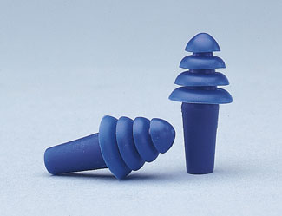
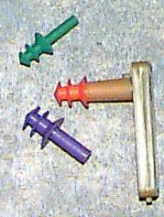
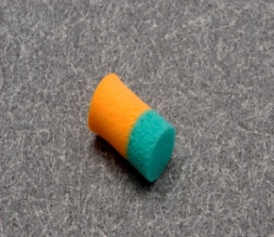
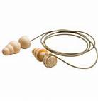
HEARING PROTECTION
Earplugs
  Pre-formed
    Single Flange
    Triple Flange
    Quad Flange
    Combat Arms Ear Plugs
  Hand-formed (foam)
Proper Fit:
  Pull back on ear to straighten ear canal
  Vacuum seal – hollow sounding voice
Nonlinear earplugs, e.g., Combat Arms
  Button flat when in vehicles or aircraft
  Button at an angle when firing
Tactical Communications and Protective Systems
Notes:
In order to mitigate the threat of damage to hearing from hazardous noise, the dangerous sounds must be stopped before reaching the eardrum and setting the chain into motion. That is done effectively with well-fit hearing protection. Earplugs must be fit individually to each Soldier since size varies between individuals in the same way helmet size varies. A Soldier may even have two different sized ears, requiring different earplugs for proper protection.
a. Soldiers need to use the proper size of earplug to protect their hearing. Once fit by trained personnel, they need to remember their size. How do they know what size they wear? By the color.
b. Earplugs are like a plug in a sink, if the plug is too big or too small, the water will leak out. Noise will leak through openings and reach the eardrum, if the earplug is too small or too big.
c. Proper earplug insertion requires straightening of the ear canal. The human ear canal is “s” shaped to protect the eardrum. If it isn’t straightened, the earplug will hit the first wall and not fit snugly or fall out. Pull back and up on the ear with the opposite hand while inserting the earplug. Make sure it is inserted until a tight seal (not painful) is obtained.
d. If the earplugs are fitting properly, the Soldier should be able to do a self-check of the fit. Soldiers can test earplug fit by talking out loud. If his or her voice sounds deeper or lower-pitched than normal, or in the center of the head (as with a ‘head cold’), the fit should be good. Surrounding, background sounds should sound softer or muffled.
e. There are different types of earplugs, including the standard preformed (triple flange, quad flange and single flange), hand formed (foam), nonlinear earplugs with two settings, and tactical communications and protective systems (TCAPS). All perform similar functions (protect hearing) but impact communication differently.
f. The combat arms earplugs allow Soldiers to change the settings based on the type of noise present. In the “combat” setting, Soldiers can hear voices and radios normally (or low level sounds in combat), but when a weapon is fired or an explosion occurs, the noise is dissipated by the tubing in the earplug before it reaches the eardrum. It allows the Soldier to maintain situational awareness “outside the wire”, but still be protected from weapon fire. If the hazardous noise is steady-state, meaning continuous (i.e.; generators, vehicle engines or aircraft), this setting on the CAE can be changed to become a regular earplug that prevents hazardous, continuous noise from reaching the eardrum.

Slide 13
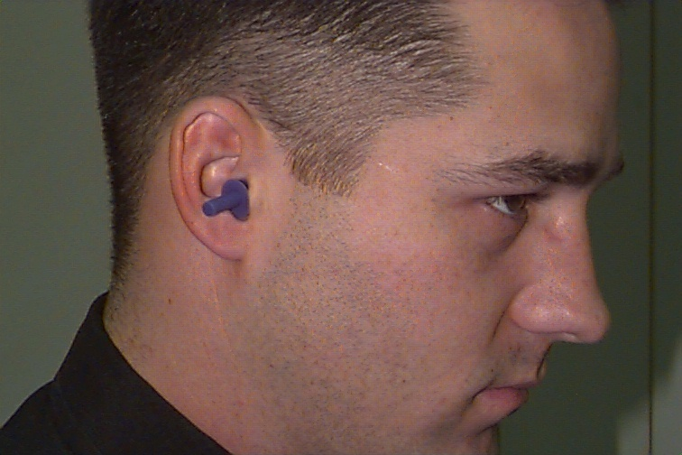
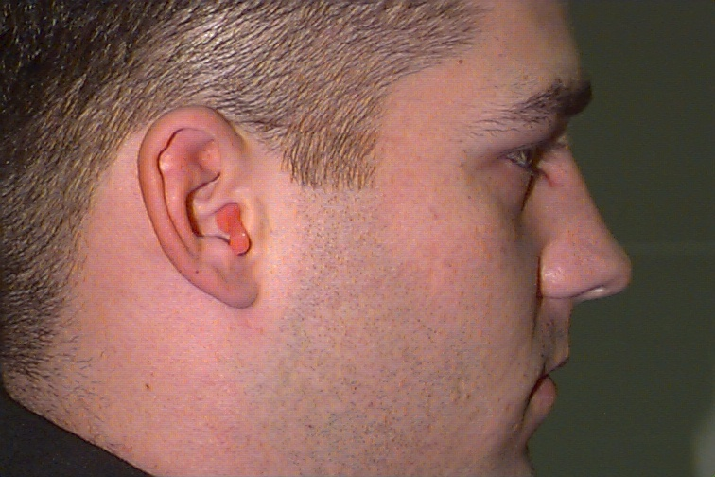
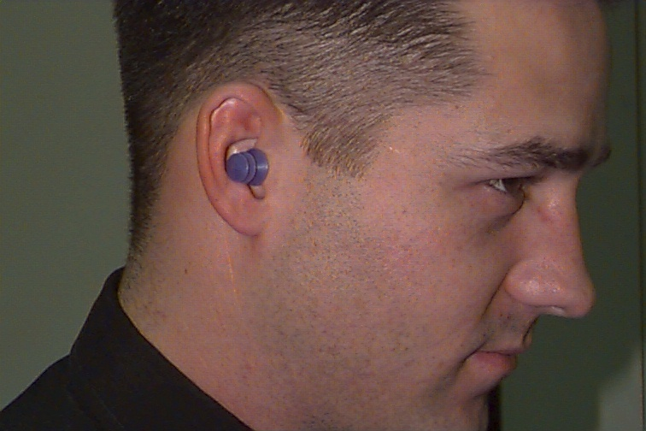
How’s the fit?
Triple Flange Earplugs
with
Insertion Tool
2
1
3
Notes:
Picture #1 Good fit/bad fit? Answer: bad fit. Picture #1 Good fit/bad fit? Answer: good fit. The last flange is sealing the opening of the ear canal.
Picture #2. Good fit/bad fit? Answer: bad fit. The earplug is too big, the last flange isn’t able to seal the opening of the ear canal because it can’t be inserted deep enough. An earplug that is too big also cannot obtain a proper seal for protection.
Picture #3. Good fit/bad fit? Answer: bad fit. The earplug is inserted backwards with the stem in the ear canal.
WARNING: One of the most obvious signs of an earplug that is too big is if the flange is folding over on itself. The groove in the earplug actually creates and holds open an entryway for noise. If the earplug is folded in anyway, the Soldier needs the next smaller size.

Slide 14
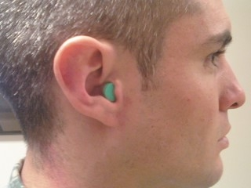

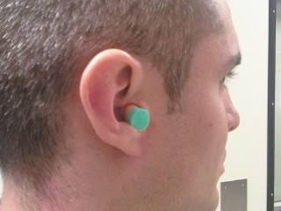
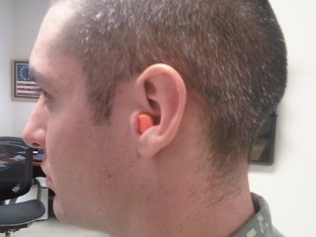
How’s the fit?
2
Bi-Colored
Foam Earplug
1
3
Notes:
Foam earplugs have both advantages and disadvantages. Advantages include comfort and the universal fit for the majority of individuals. Disadvantages include the availability (not all noise hazardous areas have foam earplugs available), one-time use (raises cost of supplying units), a small risk of transmitting chemicals or oil from hands or gloves to the earplugs, and the high likelihood of inadequate insertion for protection.
Picture #1. Good fit/bad fit? Answer: bad fit. The foam earplug is not inserted deep enough. For a dual-colored earplug, proper insertion is assured when no “orange” is showing, only green. With a single-colored earplug, use the tragus as a point of reference (the tragus is the small piece of cartilage that sits at the front of the ear canal). If the foam earplug is sticking outside of the tragus, it needs to be re-inserted. The Soldier should not look like Frankenstein’s neck bolts have been moved to his ears!
Picture #2. Good fit/bad fit? Answer: good fit. Only green is showing and the earplug is in the ear canal past the tragus.
Picture #3. Good fit/bad fit? Answer: Bad fit. The orange is showing which indicates the earplug is in backwards.
WARNING: Foam earplugs do not fit everyone, especially Soldiers with small ear canals. The earplug cannot be altered (i.e., cut or trimmed) without compromising protection. If the earplug has to be altered to obtain a good fit, it is the wrong size.

Slide 15
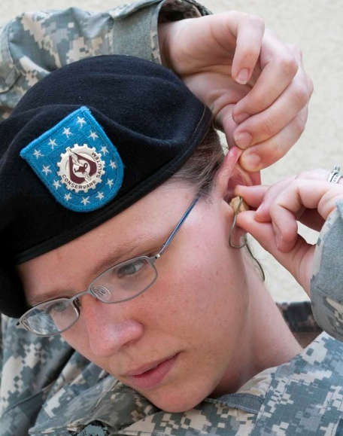
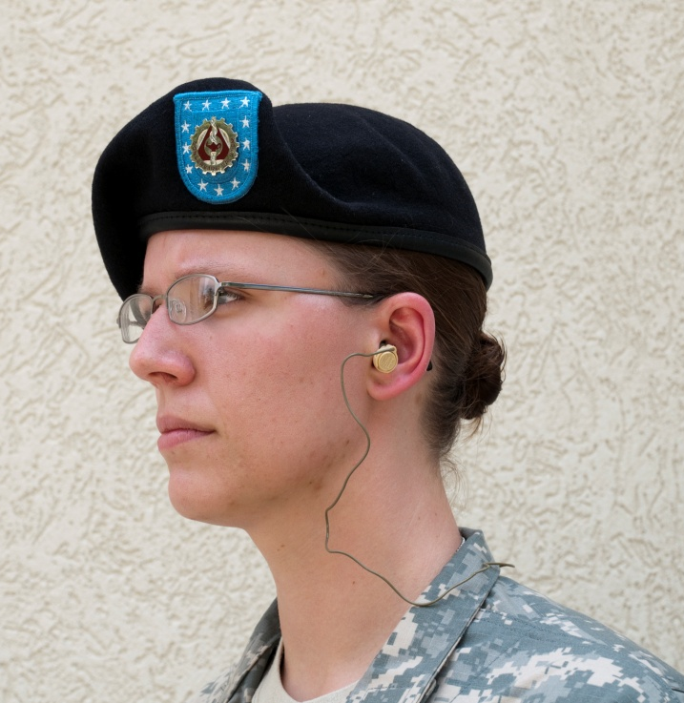
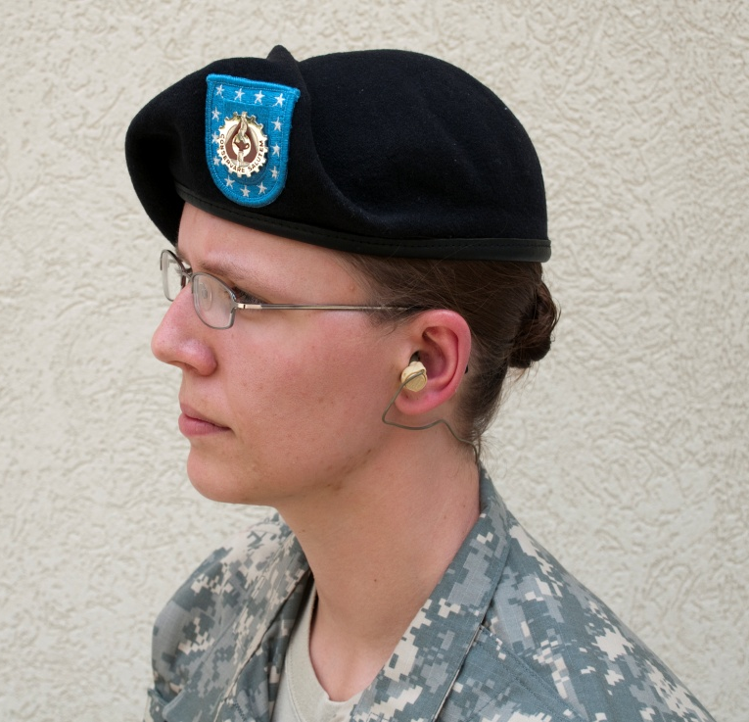
Combat Arms Earplug
Proper Fit:
  Pull back on ear to straighten ear canal
  Vacuum seal – hollow sounding voice
Good fit or Bad fit?
1
2
Notes:
Fitting the CAE is very similar to fitting the triple flange or quad flange earplug. Proper earplug insertion requires straightening of the ear canal. The human ear canal is “s” shaped to protect the eardrum. If it isn’t straightened, the earplug will hit the first wall and not fit snugly or fall out. Pull back and up on the ear with the opposite hand while inserting the earplug. Make sure it is inserted until a tight seal (not painful) is obtained.
#1: Good fit: The last flange is sealing the opening of the ear canal.
#2: Bad fit: The last flange of the ear plug is not sealing the ear canal. The ear plug appears to be falling out of the ear.

Slide 16
OPERATIONAL HEARING SERVICES
Definition:
Hearing injury prevention and communication support services delivered to the Soldier in every environment with the primary objective of enhancing survivability and lethality.
Services:
Tactical Communications and Protective Systems (TCAPS)
Noise surveillance
Injury prevention
Injury treatment

Slide 17
Consequences of Hearing Loss
Listening posts
On point and on patrol
Call for fire
  NOTE: Most fratricide occurs as a result of poor communication,
  not poor plotting or poor calculations
Urban warfare
Solutions:
Prevent hearing loss without compromising the mission
Use Tactical Communications and Protective Systems (TCAPS)
Use hearing protection specific to your mission needs
Ensure noise controls are used whenever possible

Slide 18
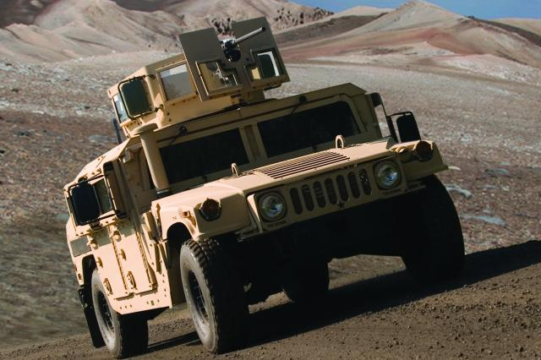
Combat Experience
Actual Event:
Vehicle contained four occupants: driver, TC, gunner, and passenger.
All occupants were wearing earplugs: two had Combat Arms Earplugs, one had triple flange, and one had foam earplugs.
An IED exploded under the driver.
Photo courtesy of US Army
Because of their hearing protection, all of the Soldiers recovered their hearing fast enough to continue evasive maneuvers while communicating with leaders.
Bottom Line: The best EARPRO is the EARPRO worn properly when needed.

Slide 19
Hearing is Critical
Soldiers must consider
EARPRO a standard part of their kit.
Track your helmet, eye protection, armor, and EARPRO.
A Soldier’s hearing is critical to survival and mission success.

Slide 20
CONCLUSION
Hearing is a critical Soldier sense
Ability to understand speech increases when background noise is reduced through EARPRO use
Noise reduction plus protection reduces fatigue
Train as You Fight – Train with EARPRO and you will fight with EARPRO
Noise-Induced Hearing Loss is NOT inevitable for the Soldier
Hearing Protection is a Critical Component of Soldier gear

Slide 21
Hearing Loss is:
  Painless
  Permanent
  Progressive
  Preventable!

